Slide 1
Unsupervised Machine Learning (ML) and Clustering Algorithms Exercise Data
Felix Gonzalez, P.E.
felix.gonzalez@gmail.com
fgonzaleumbc/DATA601.com

Slide 2
Python Clustering Example Datasets
Dataset 1: Disney Plus Movies and Shows
https://www.kaggle.com/datasets/shivamb/disney-movies-and-tv-shows
Dataset 2: Unidentified Flying Object (UFO)
https://www.kaggle.com/datasets/NUFORC/ufo-sightings?select=complete.csv
https://github.com/planetsig/ufo-reports
Dataset 3: Bible Text
https://www.kaggle.com/datasets/phyred23/bibleverses

Slide 3
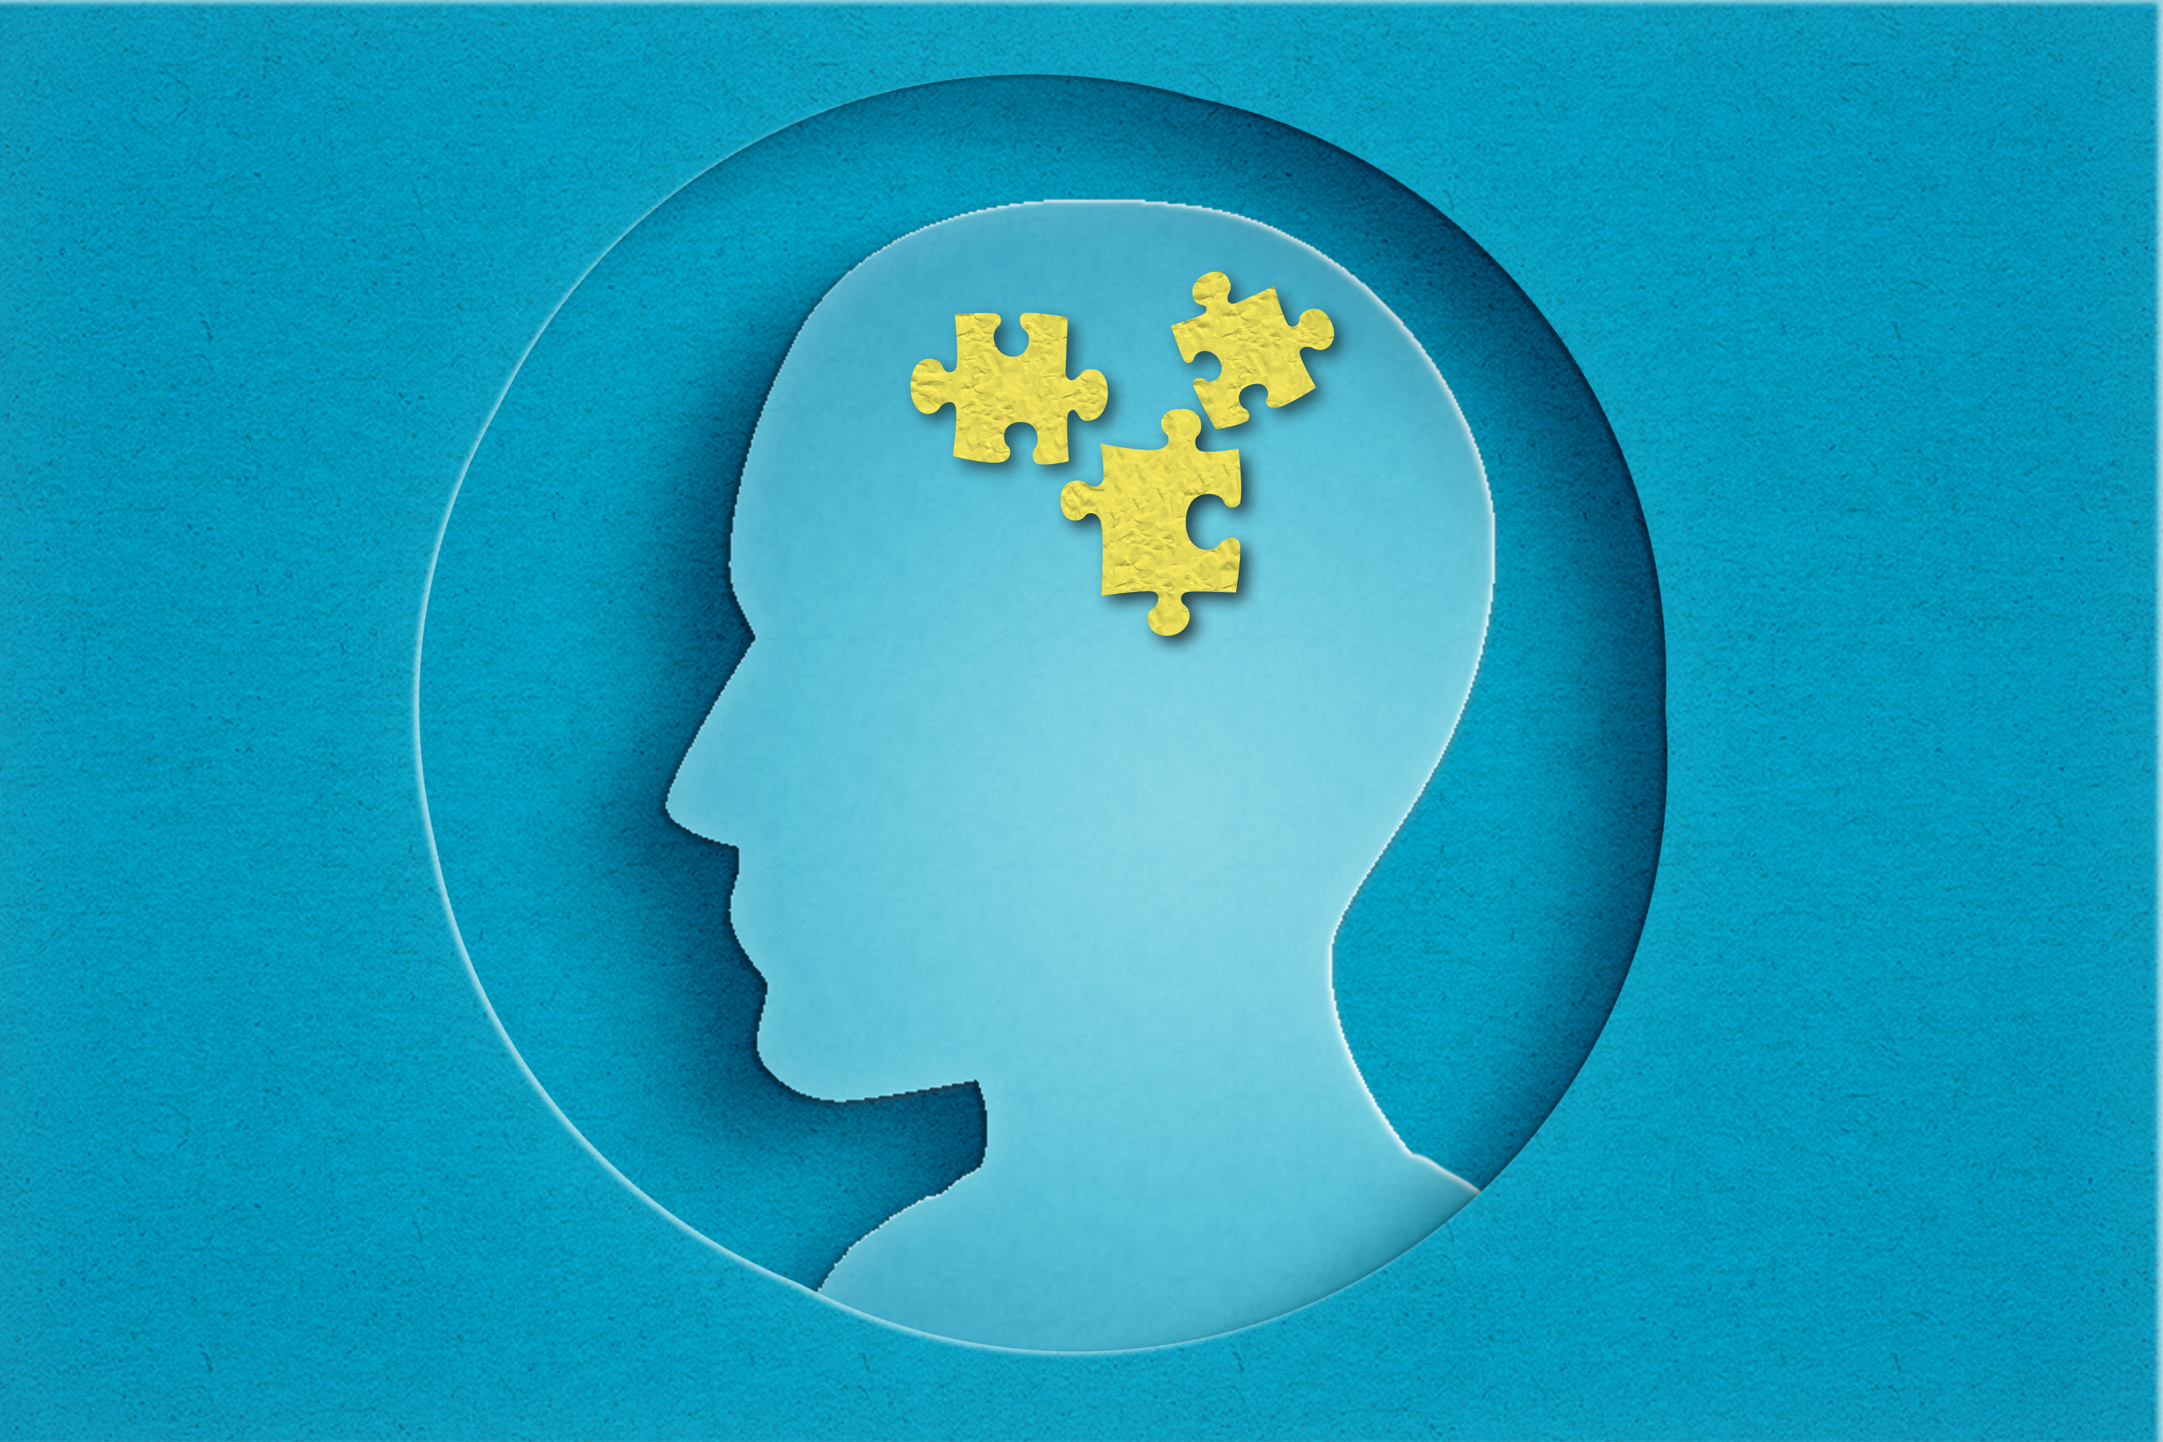
Questions?
Notes:
Marble Puzzle: What things do we do when starting a puzzle?

